Slide 2
INTRODUCTIONS
Team
Personal History
Past Projects / Startups
Set out to build something special….
Notes:
A little about me, cofounder, startups, e-commerce (didn’t know what a startup was), always some kind of hustle, worked with a startup company in Davis, wanted to do somethings great…. Created time machine
Medo: more credentials, why should people listen to me? Two or three things we’ve accomplished.

Slide 3
We built a Time Machine
No it doesn’t take you around time and space
Our time machine creates time for law firms.

Slide 4
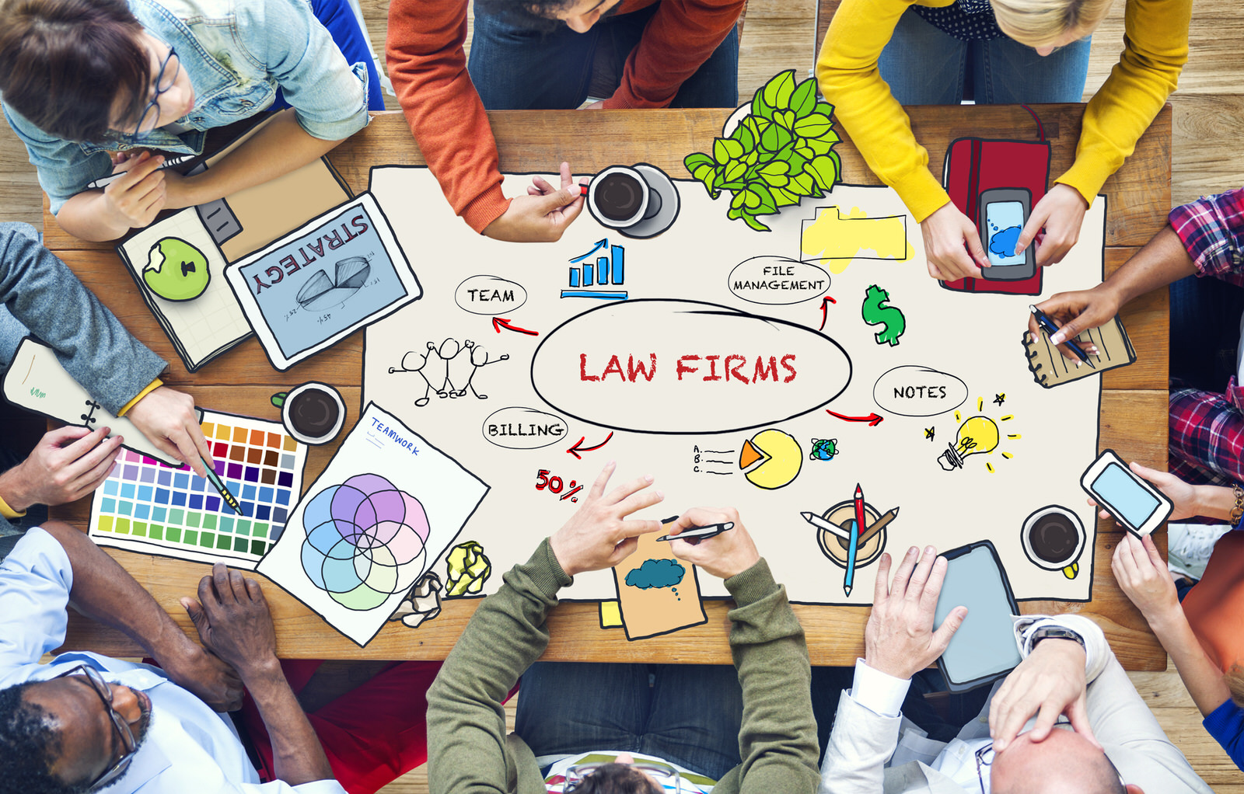
Holistic View
Looking at how a law firm operates
How does technology save law firms time and resources?
How does technology help a law firm run more smoothly, have better communication internally and externally?
How is everything connected?
We aren’t just data storage
Notes:
Holism is the idea that systems and their properties should be viewed as wholes, not just as a collection of parts.

Slide 5
Started Seeing Relations
Problem 1: Industry saw all these individual components
Everything is not these separate entities, but are highly relational
Emails relate to notes
Notes to invoices
Invoices to schedules
Schedules to Vacations
Vacations to Appointments
Notes:
Holism is the idea that systems and their properties should be viewed as wholes, not just as a collection of parts.

Slide 6
It’s Alive!!!
Data Centric
Input / Output
Problem 2: Data is stored, but you have to manually fetch it. What good is that?
Industry is Data-Centric
We are User-Centric (Kitchen example)
Data that is stored is alive and does work
Opens possibilities to integrate with physical machines like “PBX” or phone systems.
Need in the market place for innovation in the legal industry
User Centric
Input / Output
Notes:
Holism is the idea that systems and their properties should be viewed as wholes, not just as a collection of parts.

Slide 7
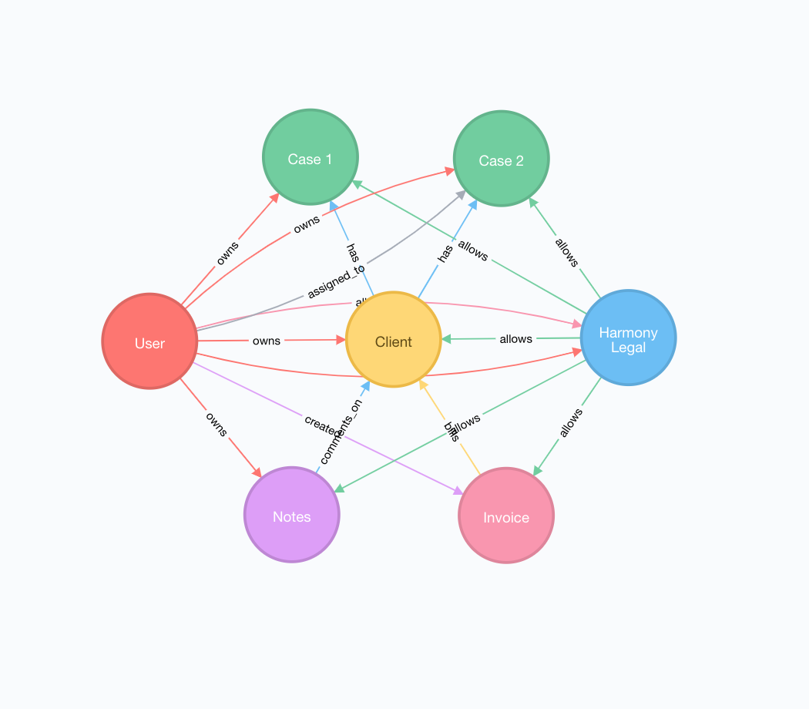
How We View Data

Slide 8
Competition / Market Share
A lot. Clio, Practice Panther, Peppermint, eImmigration, Aderant, MyCase, and myriad of smaller ones or specialty (lots of opportunity for integration)
Clio, one of the better funded raised $26M
Out of 50, 48 said they would consider switching to Harmony Legal. There were a considerable number that still used paper (single member practices)
Biggest hurdle in pulling in new users is case conversions…getting their old cases into our system.

Slide 9
Where are we?
We are about 3 months from beta
Laundry list of ideas and innovation
Pricing: $79/user per month ($99) – Projections…
Notes:
How many customers, grab

Slide 10
What do we need?
Law firms that are interested in being early adopters.
NodeJS / JavaScript Developers
Sales / Marketing

Slide 11
Senica Gonzalez
916.633.4366
hello@harmonylegal.com

